Slide 1
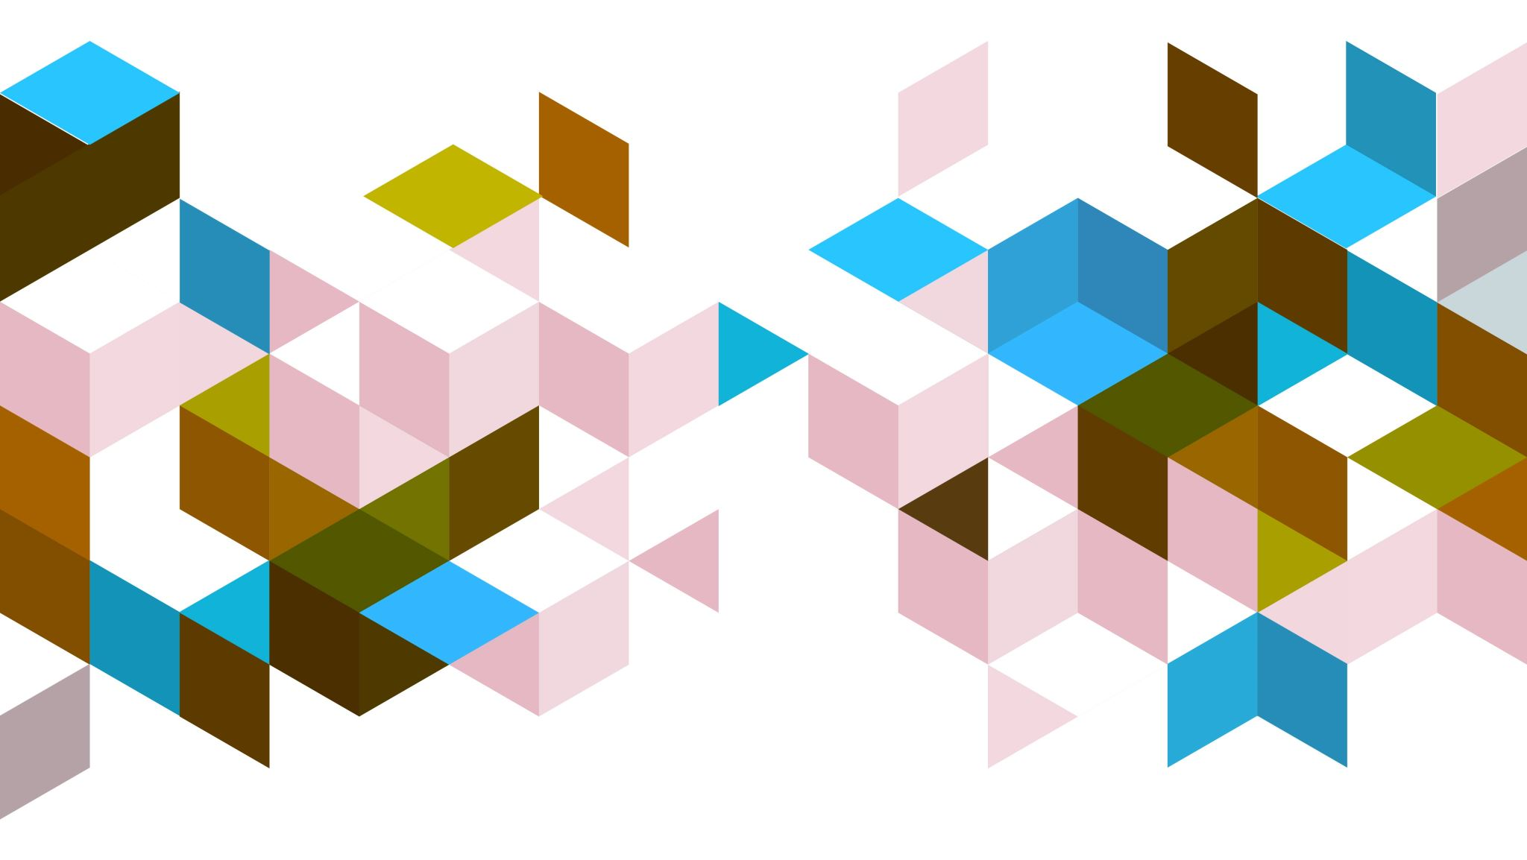
Retreival Augumented Generation(RAG)
Dr. Rakhee Chhibber

Slide 2
Introduction
Retrieval-Augmented Generation (RAG) has become a essential approach for enhancing the capabilities of Large Language Models (LLMs), enabling them to leverage external knowledge sources for more accurate and contextually relevant responses. To streamline the development of RAG systems, several powerful frameworks have emerged, each offering unique features and capabilities.
RAG frameworks –
LangChain,
LlamaIndex,
Haystack

Slide 3
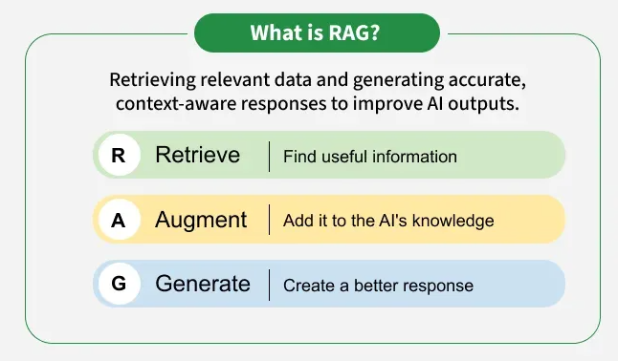

Slide 4
Importance of RAG
Access to Updated Knowledge: LLMs are trained on fixed datasets but RAG allows them to fetch fresh and real time information from external sources.
Improved Accuracy: It reduces hallucinations in LLMs and makes answers more factually correct.
Domain Specific Expertise: It lets us use specialized datasets like medical records and legal documents to get expert-level responses without retraining the model.
Cost Efficiency: Instead of retraining massive LLMs with new data, we simply update the external knowledge base hence saving time and resources.
Personalization: RAG can retrieve user specific information like past interactions or personal data to provide more tailored and relevant responses.

Slide 5
Components of RAG
External Knowledge Source: Stores domain specific or general information like documents, APIs or databases.
Text Chunking and Preprocessing: Breaks large text into smaller, manageable chunks and cleans it for consistency.
Embedding Model: Converts text into numerical vectors that capture semantic meaning.
Vector Database: Stores embeddings and enables similarity search for fast information retrieval.
Query Encoder: Transforms the user’s query into a vector for comparison with stored embeddings.
Retriever: Finds and returns the most relevant chunks from the database based on query similarity.
Prompt Augmentation Layer: Combines retrieved chunks with the user’s query to provide context to the LLM.
LLM (Generator): Generates a grounded response using both the query and retrieved knowledge.
Updater (Optional): Regularly refreshes and re-embeds data to keep the knowledge base up to date.

Slide 6
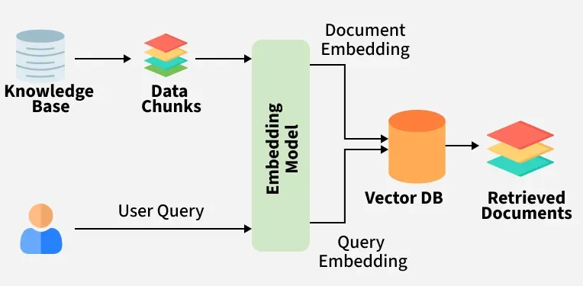
Working of RAG

Slide 7
Vector Databases
A vector database is a specialized type of database designed to store, index and search high dimensional vector representations of data known as embeddings. Unlike traditional databases that rely on exact matches vector databases use similarity search techniques such as cosine similarity or Euclidean distance to find items that are semantically or visually similar.

Slide 8
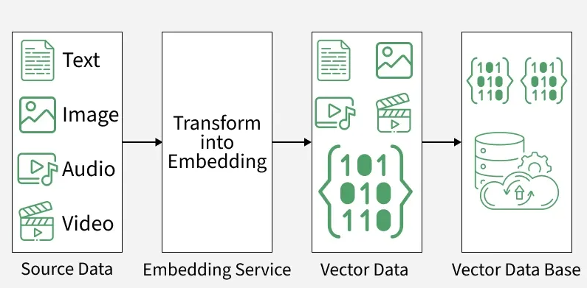

Slide 9
Popular Vector Databases
Pinecone: Fully managed, cloud native vector database with high scalability and low latency search.
Weaviate: Open source, supports hybrid (keyword + vector) search and offers built in machine learning modules.
Milvus: Highly scalable, open source database optimized for large scale similarity search.
Qdrant: Open source, focuses on high recall, performance and ease of integration with AI applications.
Chromadb: Lightweight, developer friendly vector database often used in LLM powered applications.
Faiss: - is an open-source library for vector search created by Facebook
https://www.datacamp.com/blog/the-top-5-vector-databases

Slide 10
import faiss
import numpy as np
data_vectors = np.array([
[0.1, 0.2, 0.3, 0.4],
[0.2, 0.1, 0.4, 0.3],
[0.9, 0.8, 0.7, 0.6],
], dtype='float32')
dimension = data_vectors.shape[1]
index = faiss.IndexFlatL2(dimension)
index.add(data_vectors)
query_vector = np.array([[0.1, 0.2, 0.3, 0.35]], dtype='float32')
distances, indices = index.search(query_vector, k=2)
print("Indices of closest vectors:", indices)
print("Distances from query:", distances)
FAISS stands for Facebook AI Similarity Search.

Slide 11
⚙️ What FAISS actually does
FAISS:
Stores vectors (arrays of numbers, usually embeddings)
Quickly finds nearest neighbors
Uses smart math + indexing to avoid brute-force search
It supports:
Exact search (perfect but slower)
Approximate search (slightly less perfect, much faster)
CPU and GPU acceleration

Slide 12
What Problems does RAG solve?
Hallucinations: Traditional generative models can produce incorrect information. RAG reduces this risk by retrieving verified, external data to ground responses in factual knowledge.
Outdated Information: Static models rely on training data that may become outdated. It dynamically retrieves latest information ensuring relevance and accuracy in real time.
Contextual Relevance: Generative models often struggle with maintaining context in complex or multi turn conversations. RAG retrieves relevant documents to enrich the context improving coherence and relevance.
Domain Specific Knowledge: Generic models may lack expertise in specialized fields. It integrates domain specific external knowledge for tailored and precise responses.
Cost and Efficiency: Fine tuning large models for specific tasks is expensive. It eliminates the need for retraining by dynamically retrieving relevant data reducing costs and computational load.
Scalability Across Domains: It is adaptable to diverse industries from healthcare to finance without extensive retraining making it highly scalable

Slide 13
Rag Applications
Question-Answering Systems: It enables chatbots or virtual assistants to pull information from a knowledge base or documents and generate accurate, context aware answers.
Content Creation and Summarization: It can gather information from multiple sources and generate concise, simplified summaries or articles.
Conversational Agents and Chatbots: It enhances chatbots by grounding their responses in reliable data making interactions more informative and personalized.
Information Retrieval: Goes beyond traditional search by retrieving documents and generating meaningful summaries of their content.
Educational Tools and Resources: Provides students with explanations, diagrams or multimedia references tailored to their queries.

Slide 14
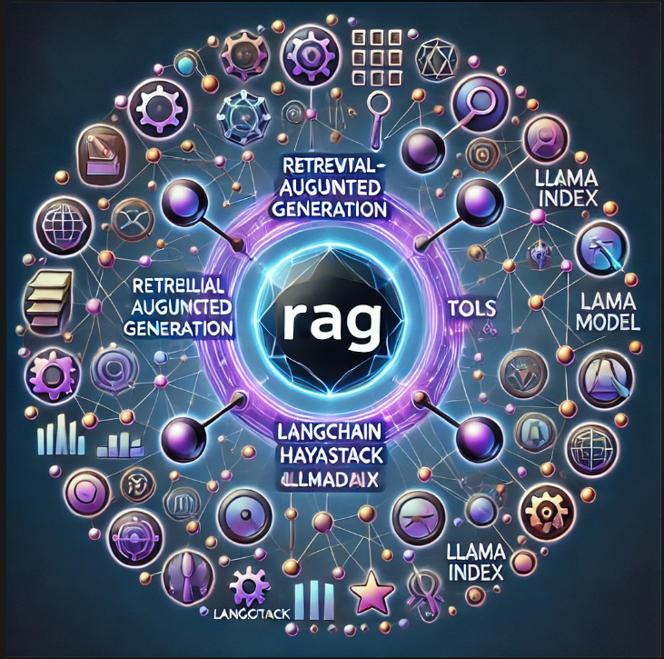

Slide 15
RAG Components
Indexing: a pipeline for ingesting data from a source and indexing it. This usually happens offline.
Retrieval and generation: the actual RAG chain, which takes the user query at run time and retrieves the relevant data from the index, then passes that to the model.

Slide 16
RAG Lifecycle - Indexing
Data Ingestion: Loading data from various sources, including files, databases, and APIs. Load: First we need to load our data. This is done with Document Loaders.
Data Preprocessing: Cleaning, chunking, and embedding text data into a vector format.
Split: Text splitters break large Documents into smaller chunks. This is useful both for indexing data and passing it into a model, as large chunks are harder to search over and won't fit in a model's finite context window.
Store: We need somewhere to store and index our splits, so that they can be searched over later. This is often done using a VectorStore and Embeddings model.

Slide 17
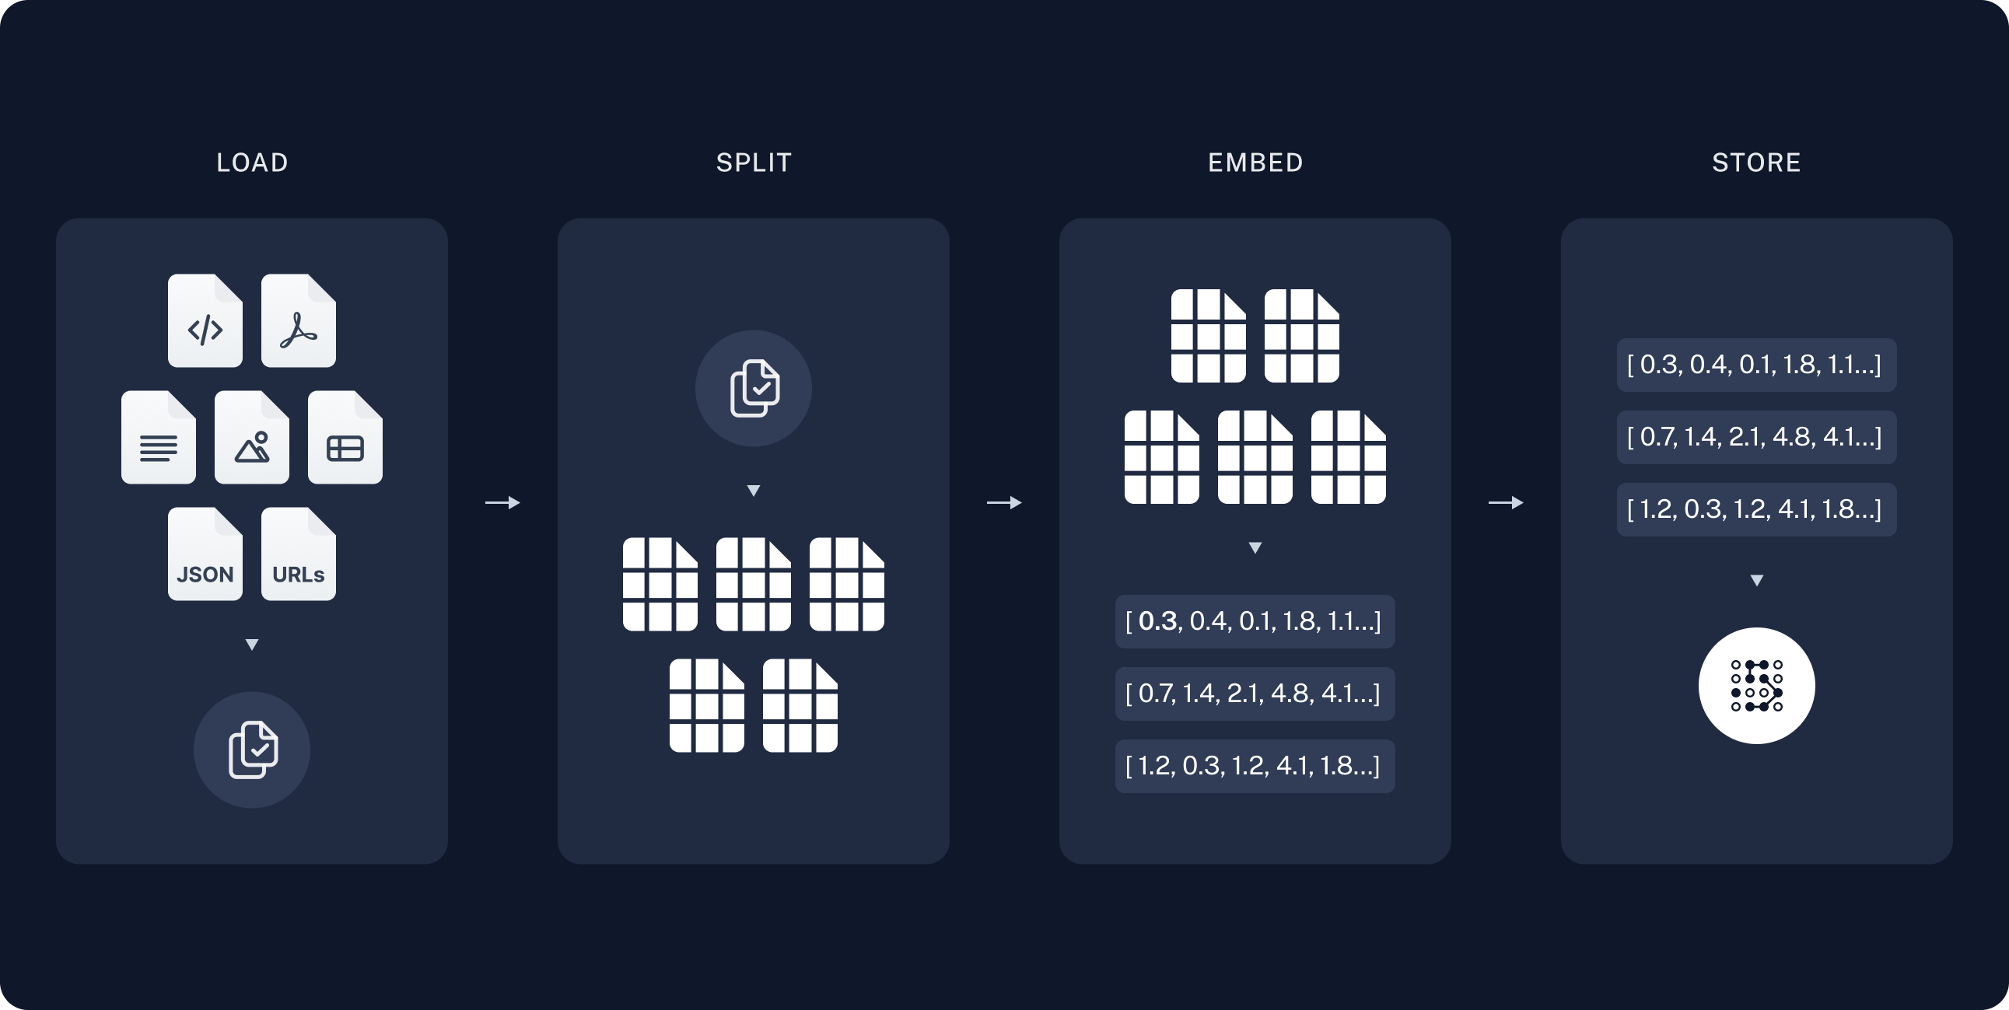

Slide 18
Retrieval and Generation
Retrieval: Searching for relevant context based on the user query. Given a user input, relevant splits are retrieved from storage using a Retriever.
Context Augmentation: Combining retrieved context with the user query.
Response Generation: Using an LLM to generate a coherent and contextually rich response. A ChatModel / LLM produces an answer using a prompt that includes both the question with the retrieved data
Evaluation and Iteration: Measuring the quality of responses and making improvements as needed.

Slide 19
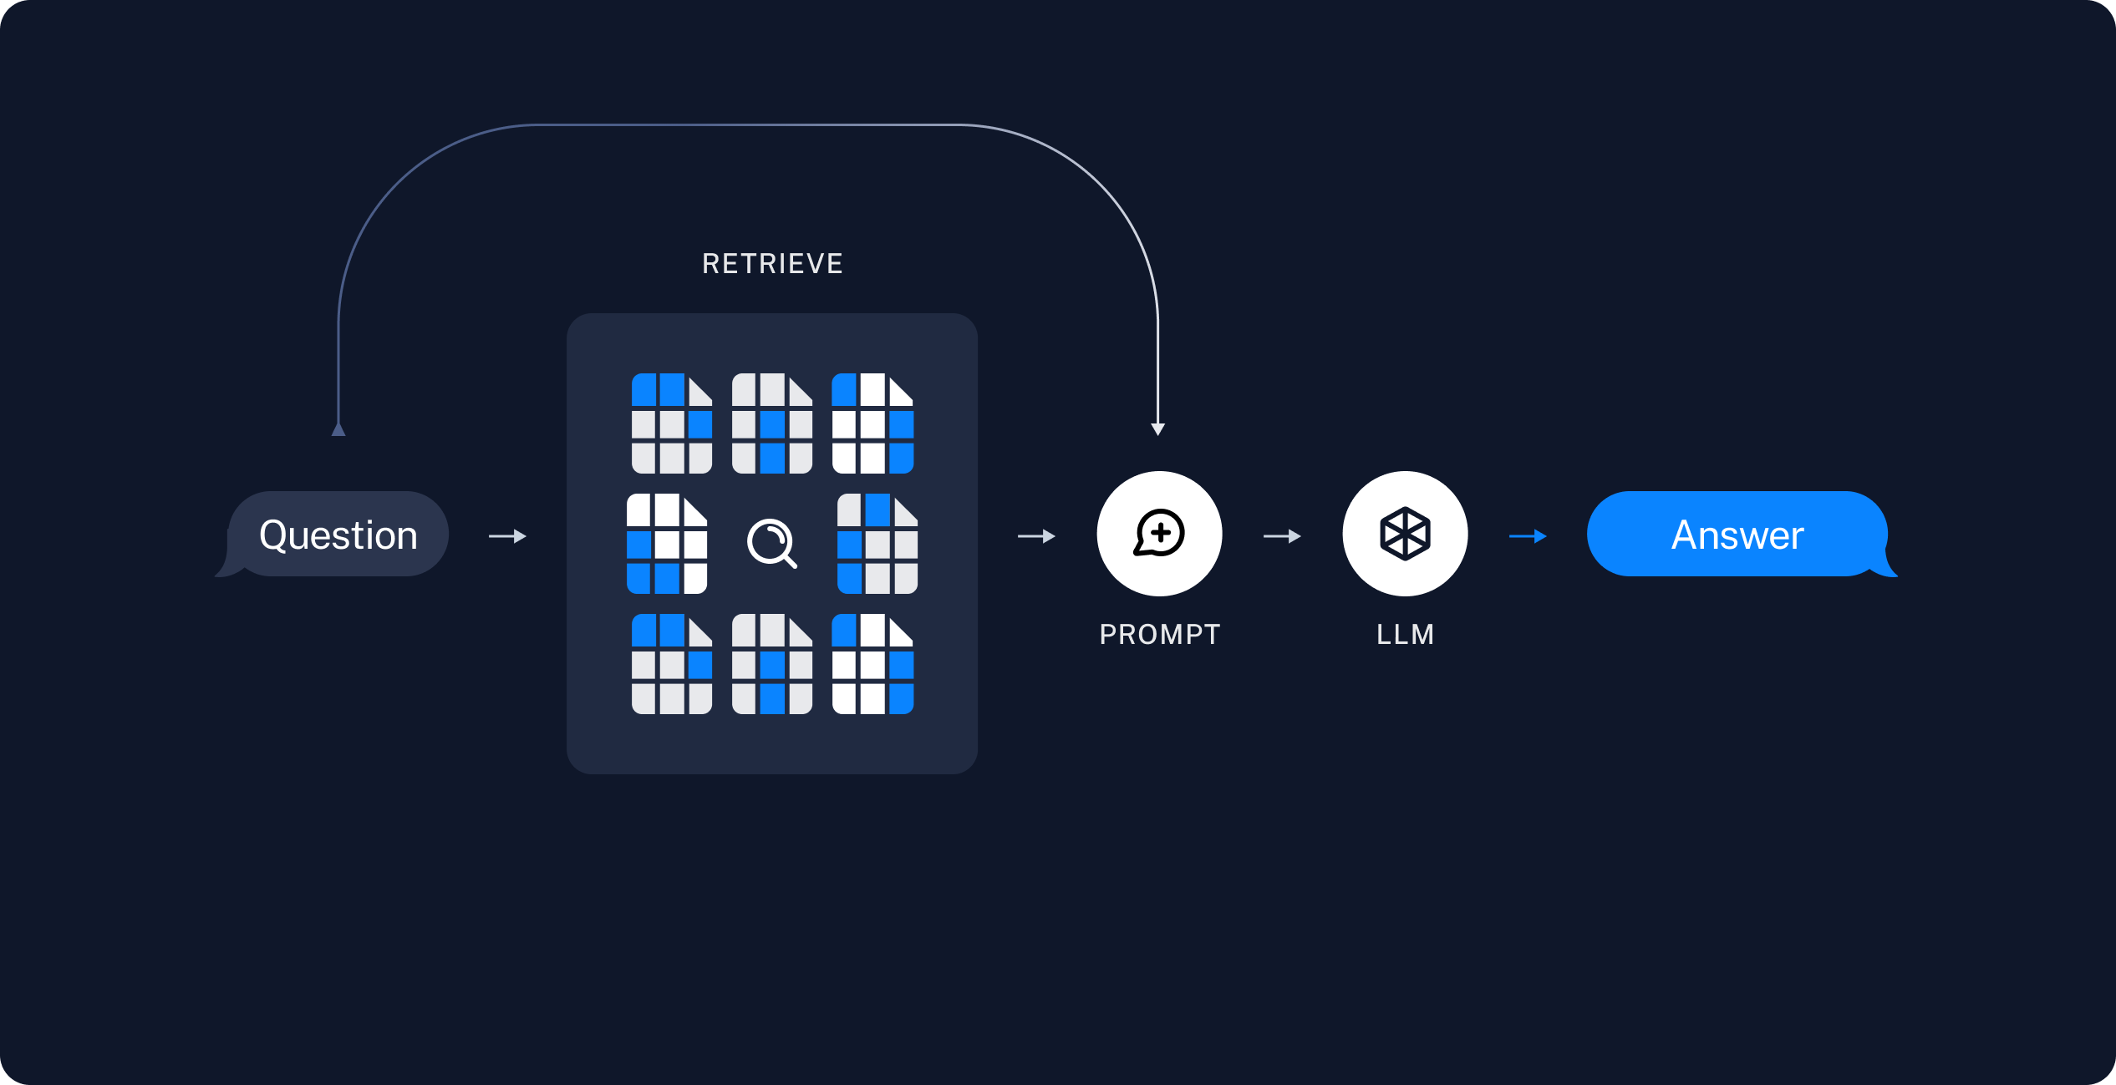

Slide 20
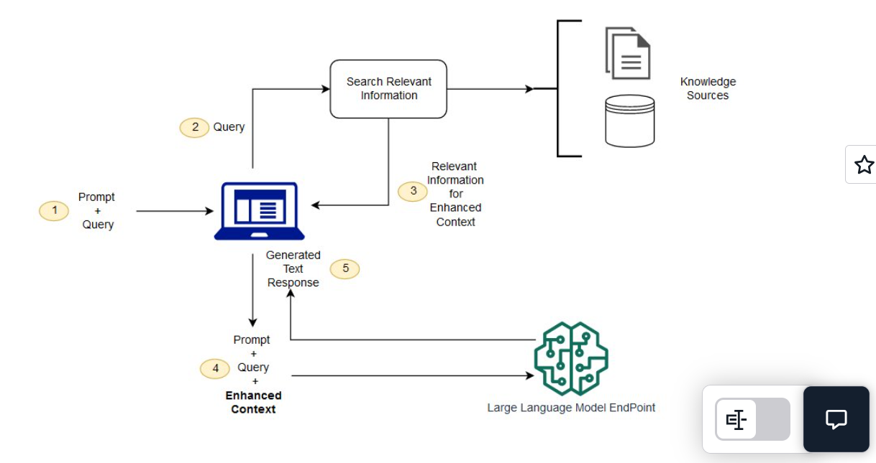
Complete RAG pipeline
RAG

Slide 21
Types of RAG
Graph RAG: In this type of RAG, the knowledge source is represented as a graph, where nodes are entities and edges are relationships between entities. The language model can traverse the graph to retrieve relevant information.
Hybrid RAG: a type of RAG that combines Knowledge Graphs (KGs) and vector database techniques to improve question-answering systems.
Modular RAG: a type of RAG that goes beyond the basic "retrieve-then-generate" process, employing routing, scheduling, and fusion mechanisms to create a flexible and reconfigurable framework. This modular design allows for various RAG patterns (linear, conditional, branching, and looping), enabling more sophisticated and adaptable knowledge-intensive applications

Slide 22
RAG Alternatives
Method | Description | When to Use
Prompt Engineering | Adjusts the input prompt to guide model behavior without changing its training. | When you need a quick and simple solution for specific tasks or queries.
Retrieval-Augmented Generation (RAG) | Combines retrieval and generation to use external data for more factual and context-aware responses. | When you want the model’s responses to include real-time, relevant information from external sources.
Fine-Tuning | Retrains the model on a smaller, domain-specific dataset. | When you need better performance on a particular topic or industry data.
Pre-Training | Trains the model from scratch using a large and diverse dataset. | When you want to build a strong foundation for later customization and adaptation.

Slide 23
RAG Frameworks and Their Features
LangChain
LlamaIndex (GPT Index)
Haystack
LangGraph
RagBuilder
RAGFlow

Slide 24
LangChain
Description: LangChain is a comprehensive framework for building LLM applications. It provides modules for various tasks, including prompt management, model integration, data retrieval, and agent creation.
Lifecycle: LangChain offers components for the entire RAG lifecycle and an orchestration framework to combine them in any desired order.
Ingestion: Supports diverse data sources (files, websites, databases).
Preprocessing: Provides tools for text splitting, chunking, and embeddings.
Retrieval: Integrates with vector databases and search tools.
Augmentation: Handles context injection in prompts.
Generation: Allows seamless integration with various LLMs.

Slide 25
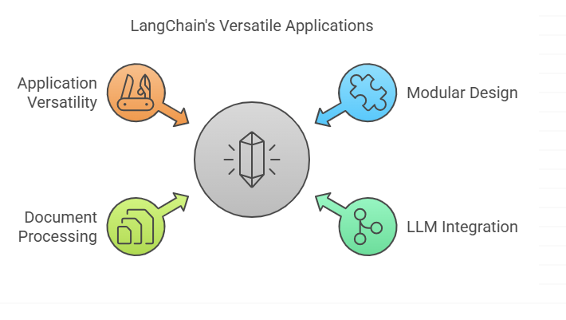
Applications of LangChains

Slide 26
Applications
Modular design: LangChain is built on a plug-and-play architecture, so you can easily mix and match components such as retrievers, LLMs, and post-processors.
Seamless integration with LLMs: Whether you’re using OpenAI’s GPT models, Hugging Face transformers, or other generative systems, LangChain provides native support for a wide range of models.
Document processing tools: The framework includes features to handle unstructured data, such as splitting long documents, extracting metadata, and pre-processing text for optimal retrieval.
Versatility in applications: From simple Q&A systems to complex multi-turn dialogues and intelligent copilots, LangChain is well-suited for a variety of use cases.

Slide 27
Example:
Building a document QA system that retrieves information from multiple PDF files and uses the retrieved content to answer user queries.

Slide 28
from langchain.document_loaders import PyPDFLoader from langchain.text_splitter import RecursiveCharacterTextSplitter from langchain.embeddings import OpenAIEmbeddings from langchain.vectorstores import FAISS from langchain.chains import RetrievalQA from langchain.llms import OpenAI # 1. Data Ingestion loader = PyPDFLoader("example.pdf") documents = loader.load() # 2. Data Preprocessing text_splitter = RecursiveCharacterTextSplitter(chunk_size=1000, chunk_overlap=200) chunks = text_splitter.split_documents(documents) embeddings = OpenAIEmbeddings() vector_store = FAISS.from_documents(chunks, embeddings)

Slide 29
# 3. Retrieval & Augmentation retriever = vector_store.as_retriever() # 4. Response Generation llm = OpenAI() qa_chain = RetrievalQA.from_chain_type(llm=llm, retriever=retriever) query = "What are the key findings?" response = qa_chain.run(query) print(response)

Slide 30
Pros & Cons
Pros:
Highly flexible and customizable.
Extensive library of components.
Large community and strong support.
Supports diverse data sources and models.
Cons:
Can have a steep learning curve.
Can be verbose for simple RAG implementations.
Needs manual configuration and management.

Slide 31
LlamaIndex (GPT Index)
Description: LlamaIndex focuses specifically on data indexing and retrieval for LLM applications. It provides data connectors, index structures, and query interfaces designed for RAG.
Lifecycle: LlamaIndex offers tailored tools for indexing data and retrieving context for LLMs.
Ingestion: Offers various data loaders and connectors (e.g., PDFs, websites, databases).
Indexing: Supports different index types like vector indexes and keyword indexes.
Retrieval: Offers query engines and retrievers for efficient context selection.
Augmentation: Can combine retrieved context with prompts.
Generation: Easy integration with any LLM.

Slide 32
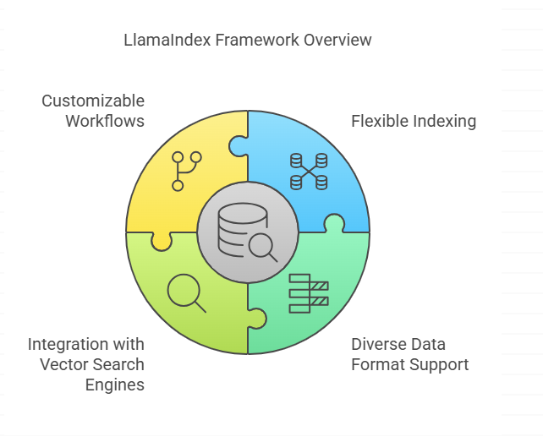
LlamaIndex is known for its exceptional ability to handle both structured and unstructured data, making it a go-to choice for enterprise-level implementations. Its core strength lies in the efficient creation of indices that allow rapid retrieval from a diverse range of data sources, such as PDFs, relational databases, APIs, and more.

Slide 33
Applications
Flexible indexing capabilities: LlamaIndex can build high-performance indices that scale effortlessly, enabling swift retrieval even in large and complex data environments.
Support for diverse data formats: The framework can process and index information from documents, tables, spreadsheets, APIs, and other sources without requiring extensive preprocessing.
Integration with vector search engines: It works seamlessly with modern vector stores like Pinecone and FAISS, allowing for highly efficient similarity searches.
Customizable workflows: Its modular components let developers tailor RAG pipelines to meet the exact needs of their projects.

Slide 34
Example:
Creating a chatbot that answers questions based on the content of your website using a vector store based index.

Slide 35
from llama_index import VectorStoreIndex, SimpleDirectoryReader from llama_index import StorageContext, load_index_from_storage from llama_index import VectorStoreIndex from llama_index.llms import OpenAI import os # 1. Data Ingestion documents = SimpleDirectoryReader("website_data").load_data() # 2. Data Indexing index = VectorStoreIndex.from_documents(documents) # 3. Retrieval & Generation query_engine = index.as_query_engine() query = "What is your product about?" response = query_engine.query(query) print(response)

Slide 36
Pros & Cons
Pros:
Simplified data indexing and querying.
Designed specifically for RAG with focus on context.
User-friendly API for common tasks.
Good for integrating with data sources and vector databases.
Cons:
Less flexibility compared to LangChain for end to end workflow.
Can be more limited when incorporating agents.
Focus is primarily indexing and retrieval; not the complete pipeline.

Slide 37
Haystack
Description: Haystack is an open-source framework designed for building search and question-answering applications with LLMs. It offers a modular architecture for building complex NLP pipelines.
Lifecycle: Haystack provides a flexible pipeline for the entire RAG process:
Ingestion: Offers connectors for various data sources (files, databases, etc.).
Preprocessing: Features processors for cleaning, splitting, and embedding data.
Retrieval: Supports dense and sparse retrieval methods (using various vector databases).
Augmentation: Provides tools for passing retrieved data to the prompt.
Generation: Allows easy integration with LLMs, including open-source models.

Slide 38
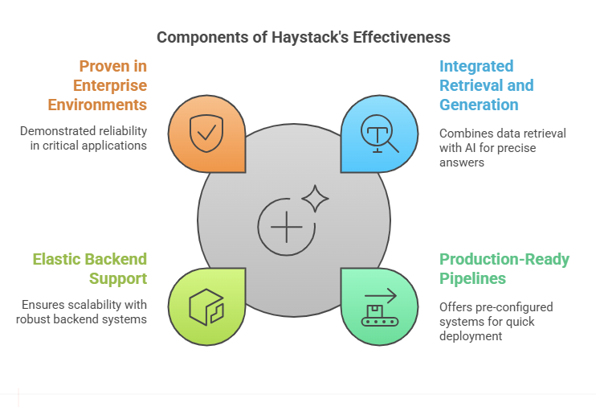

Slide 39
Integrated retrieval and generation: Haystack tightly couples retrieval with generative AI to deliver highly accurate answers.
Production-ready pipelines: It provides pre-configured pipelines for document search, Q&A systems, and hybrid search scenarios, allowing teams to move from prototype to production quickly.
Elastic backend support: Haystack works seamlessly with Elasticsearch, OpenSearch, and other IR systems, ensuring robust scalability and performance.
Proven in enterprise environments: Haystack has been battle-tested in real-world applications, making it a reliable choice for mission-critical projects.

Slide 40
Example:
Building a search system for a large document archive that can provide answers to specific questions from the documents

Slide 41
from haystack import Document from haystack.nodes import EmbeddingRetriever, SentenceTransformersTextEmbedder from haystack.nodes import FARMReader, TransformersReader from haystack.pipelines import ExtractiveQAPipeline from haystack.document_stores import InMemoryDocumentStore # 1. Data Ingestion documents = [Document(content="Document 1 content goes here."), Document(content="Document 2 content")] # 2. Document Store document_store = InMemoryDocumentStore() document_store.write_documents(documents) # 3. Text Embedding embedder = SentenceTransformersTextEmbedder(model_name_or_path="all-mpnet-base-v2“)

Slide 42
# 4. Retrieval retriever = EmbeddingRetriever(document_store=document_store, embedding_model=embedder) document_store.update_embeddings(retriever) # 5. Reader reader = FARMReader(model_name_or_path="deepset/roberta-base-squad2") # 6. Pipeline pipeline = ExtractiveQAPipeline(reader=reader, retriever=retriever) query = "What is described in Document 1?" response = pipeline.run(query=query) print(response)

Slide 43
Pros & Cons
Pros:
Modular and flexible pipeline design.
Supports diverse retrieval methods.
Good for complex NLP workflows.
Good support for open-source and commercial models.
Cons:
Can be more complex for very basic RAG implementations.
Can have a learning curve to understand the modular pipeline.
Requires setting up pipelines, might be a bit tedious.

Slide 44
LangGraph — Graph-Powered Retrieval Meets LLMs
LangGraph builds upon LangChain’s foundation by incorporating graph-based data modeling, enabling more nuanced relationships and connections between concepts. This makes it ideal for applications that need to understand and reason over complex datasets, such as knowledge graphs, ontologies, or interlinked datasets.

Slide 45
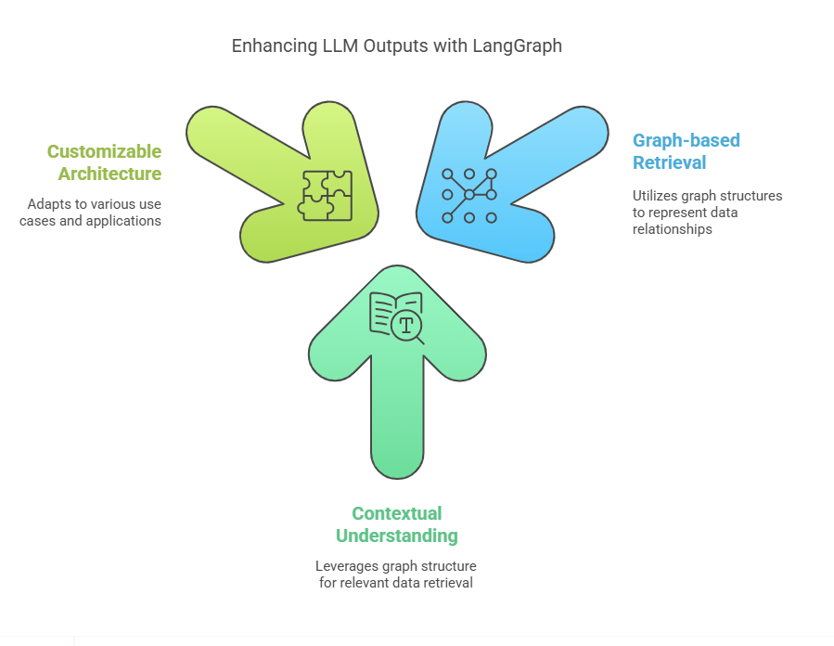
Key Highlights

Slide 46
Graph-based data retrieval: LangGraph uses graph structures to represent relationships between data points, providing richer contextual information for the LLM.
Advanced contextual understanding: By leveraging the structure of a graph, it can retrieve more relevant and interconnected data to inform generative outputs.
Highly customizable architecture: Developers can adapt LangGraph to specific use cases, ranging from relationship-aware Q&A systems to in-depth semantic search engines.

Slide 47
RAGFLOW- Bridging the Gap Between Retrieval and Generation
RAGFlow is a relatively new player that emphasizes a smooth, tightly integrated approach to retrieval and generation. It provides developers with a flexible, workflow-oriented environment to create highly customized RAG pipelines that cater to specialized use cases and niche domains.

Slide 48
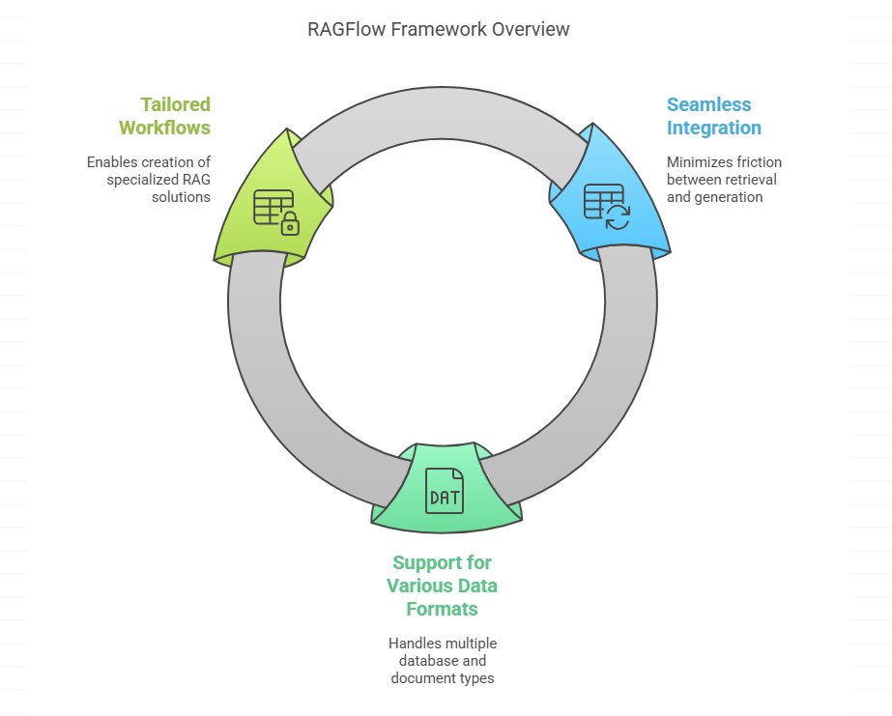

Slide 49
Seamless retrieval-generation integration: RAGFlow minimizes the friction between retrieving information and generating responses, ensuring a more cohesive pipeline.
Support for various data formats: The framework can handle multiple database and document types, giving developers the freedom to incorporate diverse data sources.
Tailored workflows: With a flexible architecture, RAGFlow enables the creation of specialized RAG solutions that meet domain-specific needs.

Slide 50
Best For:
Custom RAG projects where flexibility, control, and domain-specific adaptations are critical.
Developers who want a framework that allows for detailed customization and precise optimization.

Slide 51

Thank You

